Slide 1
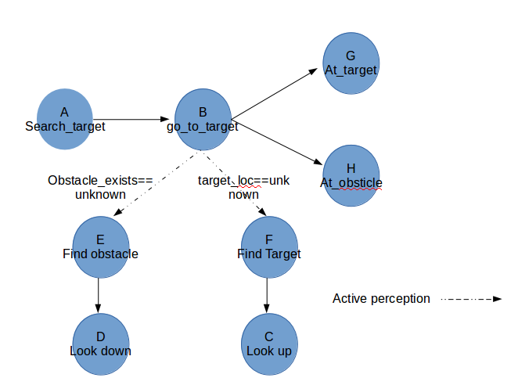
I
Termination
O
Choose_target

